Slide 1
Modern Machine Learning — K-means Algorithm
Kenneth E. Barner
Department of Electrical and Computer Engineering
University of Delaware

Slide 2
K-means Algorithm
Objective: Develop model-free methods for classification and pattern recognition
K-means is an unsupervised learning technique (does not use class label information) that separates the data into clusters
K-means converges to a solution iteratively, minimizing a cost function
Clustering algorithms can help us find patterns and interpret unlabeled data
Applications include social network analysis, search engines, and market segmentation
K-means Clustering Methodology: Establish clusters and cluster centers in a set of unlabeled data. Choose a desired number of clusters and iteratively adjust the cluster centers to minimize the within-cluster variance.
Given an initial set of cluster centers:
Identify the training points that are closest to each individual cluster center — samples closest to a given centroid constitute that centroid’s cluster
Update the cluster centroids by taking the mean of samples within a given centroid
Reiterate these steps until convergence is reached

Slide 3






K-means Algorithm
Example: Graphical illustration of K-means clustering
Examples, Centroids
$$x_{1}$$
$$x_{1}$$
$$x_{1}$$
$$x_{2}$$
$$x_{2}$$
$$x_{2}$$
Iteration 1
Iteration 2
Iteration 3

Slide 4
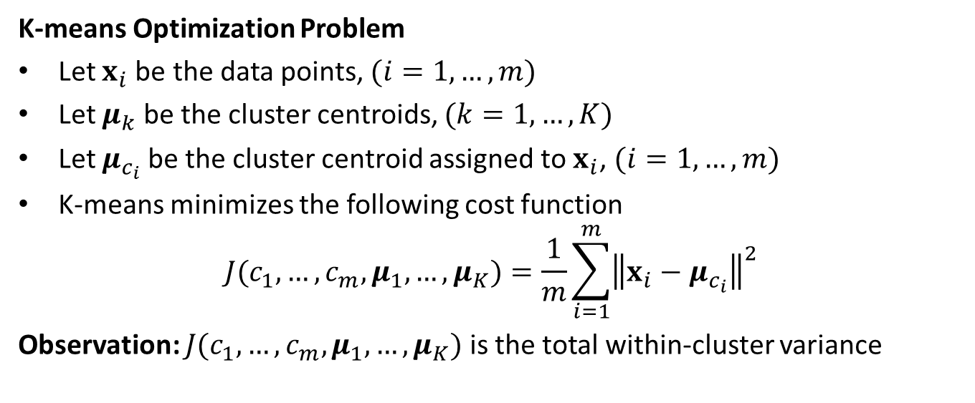
K-means Algorithm
K-means Optimization Problem
Let $x_{i}$be the data points, $(i=1,…,m)$
Let $μ_{k}$ be the cluster centroids, $(k=1,…,K)$
Let $μ_{c_{i}}$ be the cluster centroid assigned to $x_{i}$, $(i=1,…,m)$
K-means minimizes the following cost function
$$J(c_{1},…,c_{m},μ_{1},…,μ_{K})=\frac{1}{m}\sum_{i=1}^{m}{{\left\|x_{i}−μ_{c_{i}}\right\|}^{2}}$$
Observation: $J(c_{1},…,c_{m},μ_{1},…,μ_{K})$ is the total within-cluster variance

Slide 5
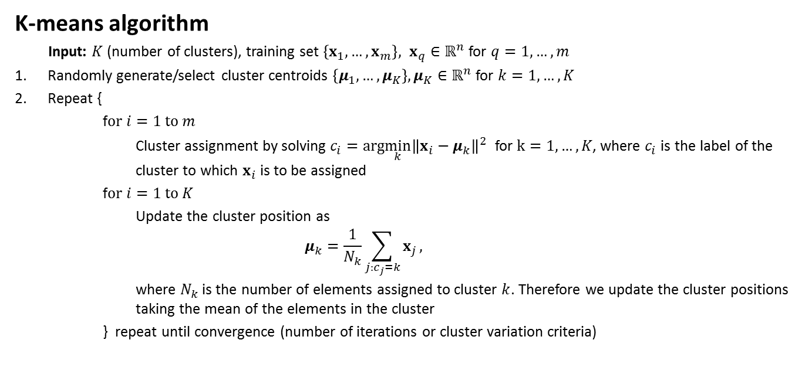
K-means Algorithm
K-means algorithm
Input: $K$ (number of clusters), training set $\left\{x_{1}, …,x_{m}\right\}, x_{q}∈ℝ^{n}$ for $q=1,…,m$
Randomly generate/select cluster centroids $\left\{μ_{1}, …,μ_{K}\right\},μ_{K}∈ℝ^{n}$ for $k=1,…,K$
Repeat {
f$or i=1 to m$
Cluster assignment by solving $c_{i}=arg\min_{k}{{\left\|x_{i}−μ_{k}\right\|}^{2}}$ for $k=1,…,K$, where $c_{i}$ is the label of the cluster to which $x_{i}$is to be assigned
f$or i=1 to K$
Update the cluster position as
$$μ_{k}=\frac{1}{N_{k}}\sum_{j:c_{j}=k}{x_{j}},$$
where $N_{k}$ is the number of elements assigned to cluster $k$. Therefore we update the cluster positions taking the mean of the elements in the cluster
} repeat until convergence (number of iterations or cluster variation criteria)

Slide 6
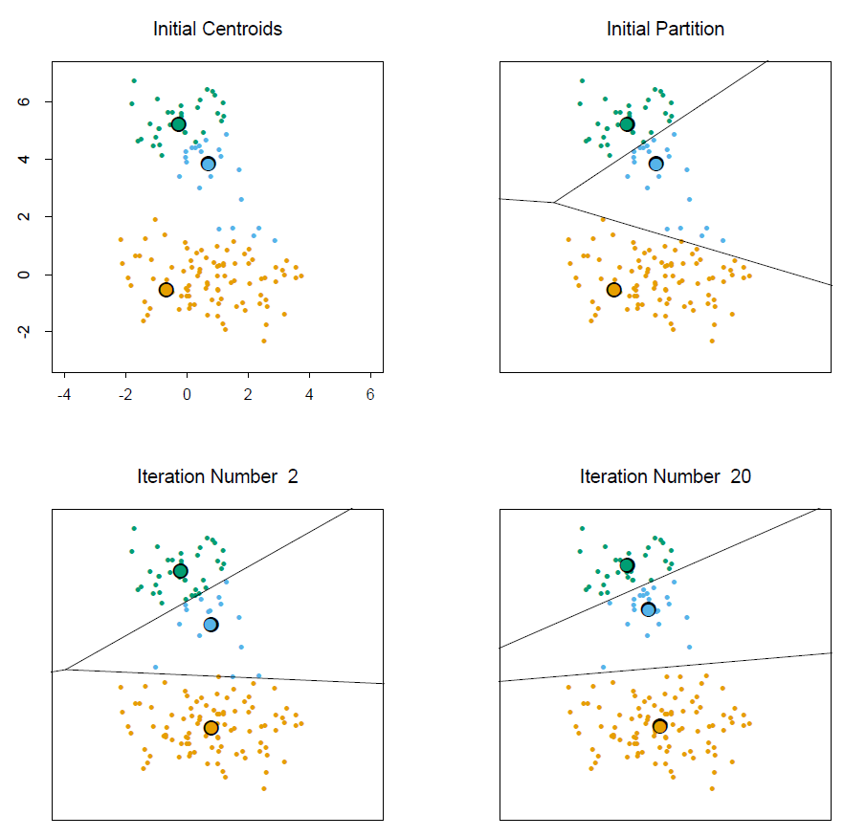
Example: K-means clustering
Note:
Cluster centroids are depicted by “O”s
Lines depict classification boundaries, determined by distance to each centroid
Convergence occurs after 20 iterations of the K-means algorithm
Observations:
The partitions form Voronoi cells and the partitioning is referred to as Voronoi tessellation
Successive iterations of the K-means clustering algorithm on data from three classes.

Slide 7
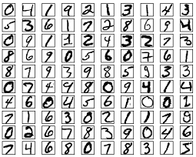
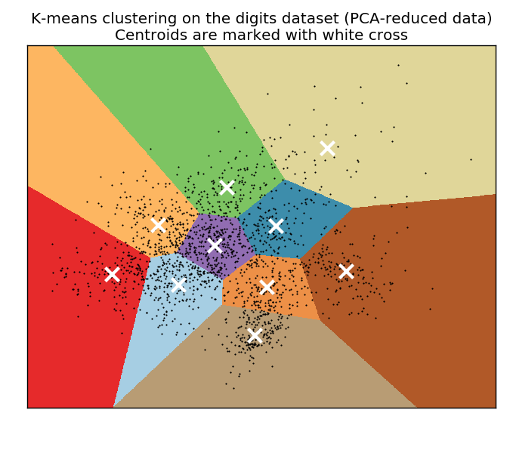
Example: K-means clustering on Handwritten Digits Classification
Training set: 60,000 examples.
Test set: 10,000 examples.
Digits have been size-normalized and centered in a fixed-size image (28x28 pixels).
Grayscale images.
Image classification benchmark
Code available from:
http://scikit-learn.org/stable/auto_examples/cluster/plot_kmeans_digits.html

Slide 8
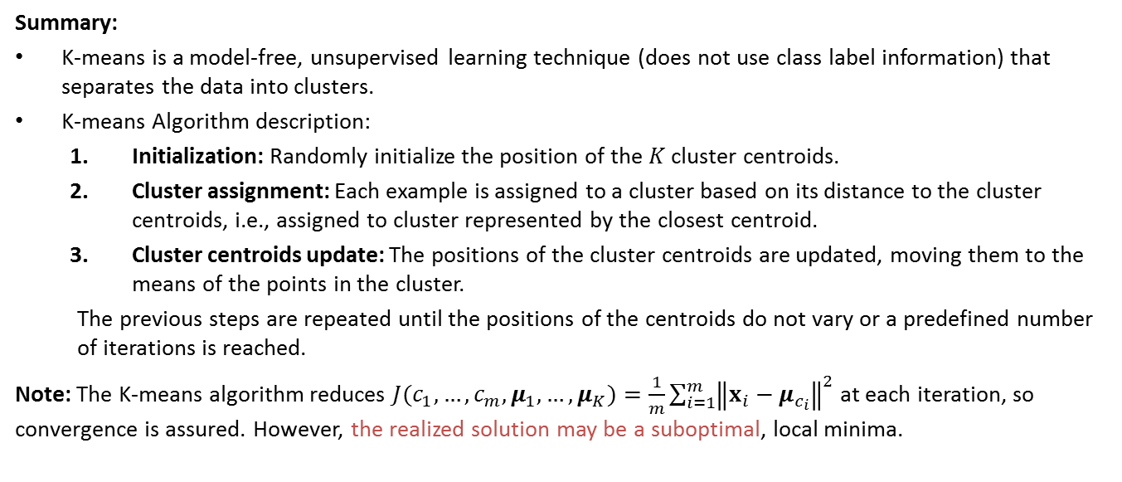
K-means Algorithm
Summary:
K-means is a model-free, unsupervised learning technique (does not use class label information) that separates the data into clusters.
K-means Algorithm description:
Initialization: Randomly initialize the position of the $K$ cluster centroids.
Cluster assignment: Each example is assigned to a cluster based on its distance to the cluster centroids, i.e., assigned to cluster represented by the closest centroid.
Cluster centroids update: The positions of the cluster centroids are updated, moving them to the means of the points in the cluster.
The previous steps are repeated until the positions of the centroids do not vary or a predefined number of iterations is reached.
Note: The K-means algorithm reduces $J(c_{1},…,c_{m},μ_{1},…,μ_{K})=\frac{1}{m}\sum_{i=1}^{m}{{\left\|x_{i}−μ_{c_{i}}\right\|}^{2}}$ at each iteration, so convergence is assured. However, the realized solution may be a suboptimal, local minima.

